Slide 1
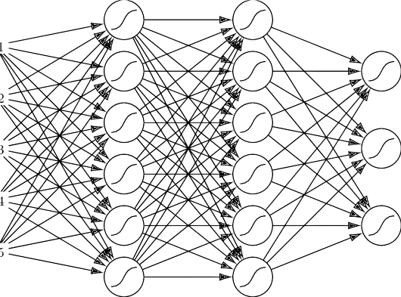
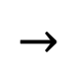
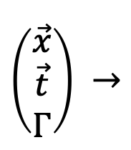
Investigating NEURAL Network architectures to solve Parametric PDES
Nicholas Cantrell
Ryan Kramlich
$\left(\begin{matrix}\vec{x} \\ \vec{t} \\ Γ\end{matrix}\right) →$
$$→$$

Slide 2
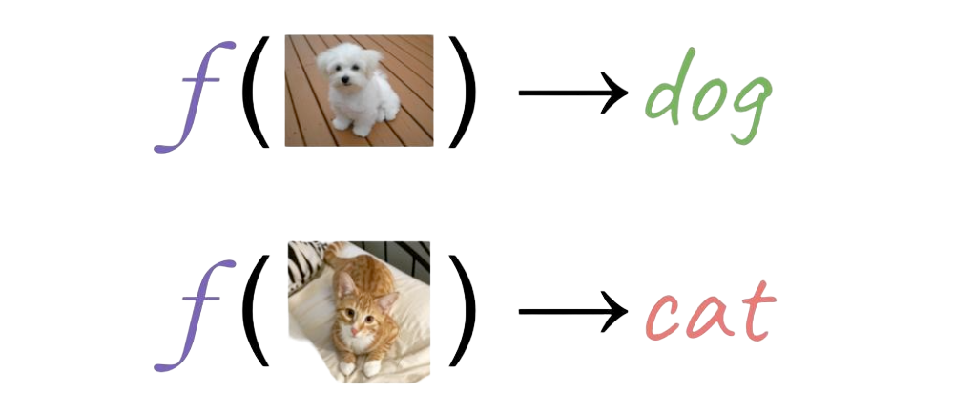
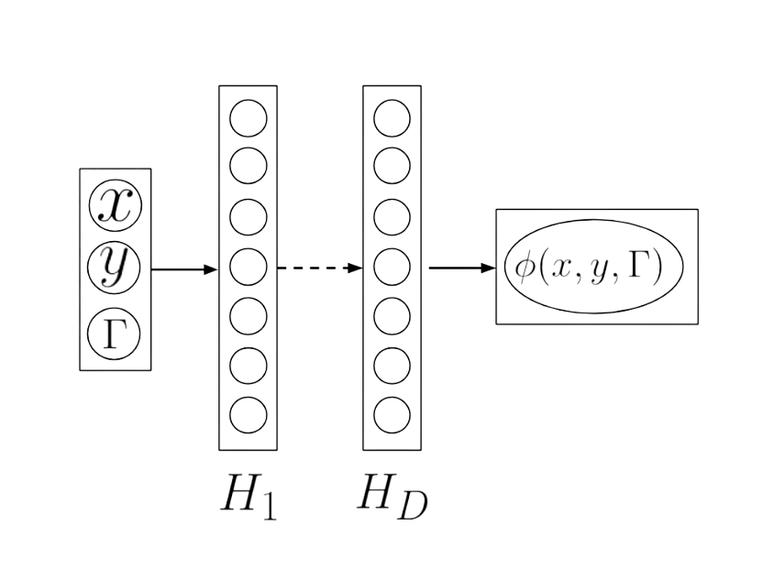
Motivation
Classically, neural networks learn the mapping between finite dimensional Euclidean Spaces
Image classification: Learns the mapping between a set image size to a finite class set
Neural Networks can be generalized of as an operator that learns the parametric dependence of a PDE
Learns the mapping form parametric dependence to an infinite functional space (1)
Traditional numerical methods posses bottlenecks due to discretization, while operator learning is agnostic to grid size
1) Li, Kovachki, et al. FOURIER NEURAL OPERATOR FOR PARAMETRIC PARTIAL DIFFERENTIAL EQUATIONS, In ICLR 2021
2) Pedro, Maroñas, Pardes. SOLVING PARTIAL DIFFERENTIAL WITH NEURAL NETWORKS, arXiv preprint arXiv:1912.04737 [phys.com.ph], 2019

Slide 3
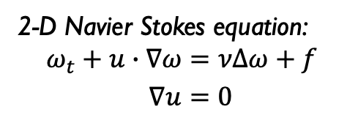
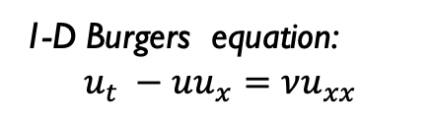
The Proposal
Goal: Investigate the use of Neural Networks to solve PDEs for fluid flow in 1D and 2D settings using various network architectures and compare to traditional numerical techniques
Experiment with both explicit time dependence (FC Networks) and implicit time dependence (RNNs)
Phase 1: Solving PDEs
1D Burgers Equation
Proof of concept with analytical solution
Augment traditional numerical methods to remove grid size bottlenecks
Extend to 2D Navier Stokes
Augment traditional numerical methods to remove grid size bottlenecks
Phase 2: Learning operators
Test NNs ability to solve PDEs on novel inputs without retraining on specific initial conditions and parameters
1-D Burgers equation:
$$u_{t} −uu_{x}=νu_{xx}$$
2-D Navier Stokes equation:
$$ω_{t}+u∙∇ω=νΔω+f$$
$$∇u=0$$

Slide 4
Proposal Elements
Relevance/Interest
Interest to Fields: Relevant to extending Neural Networks to numerically solving parametric PDEs
Personal Interest: Numerical Analysis and Novel Computational Methods as applied to PDEs and Mathematical Physics
Data:
Phase 1 data:
1-D Burgers equation analytically and numerically solved
2-D Navier-Stokes solved numerically using pseudo-spectral methods with time stepping
Phase 2 data:
1-D Burgers equation and 2-D Navier-Stokes data with Gaussian Random field ICs from Zongyi-Li repository
Domain Knowledge:
PDE and Numerical Analysis Courses, comfortable with mathematical and computational content
Usefulness:
NN accuracy is independent of grid size, unlike traditional method
Recurrent structure accommodates fluid-flow sensing applications where time-batched states aren’t available
Feasibility/Limitations:
Data Generation Code provided through the author repository
Theoretical foundation provided through justification in (1) and (2)
Concern with RNN convergence over complex input

